Slide 1

COMPUTER ORGANISATION (TỔ CHỨC MÁY TÍNH)
NUMBER SYSTEMS SUPPLEMENTARY NOTES

Slide 2
Acknowledgement
The contents of these slides have origin from School of Computing, National University of Singapore.
We greatly appreciate support from Mr. Aaron Tan Tuck Choy for kindly sharing these materials.

Slide 3
Policies for students
These contents are only used for students PERSONALLY.
Students are NOT allowed to modify or deliver these contents to anywhere or anyone for any purpose.

Slide 4
Recording of modifications
Currently, there are no modification on these contents.

Slide 5
NUMBER SYSTEMS SUPPLEMENTARY NOTES
Complements
Floating-point Numbers

Slide 6
COMPLEMENTS (1/3)
“Find the complement of a number” or “complement a number” is the short way of saying… “find the negated value in that complement system”.
For example, the two questions below are equivalent.
[4-bit] Find/get the 1’s complement of 0110 (or, 1’s complement this value: 0110) Answer: 1001.
[4-bit] If x is 0110_{1s}, what is -x in 1’s complement form? Answer: 1001_{1s}
So, “find the 1’s complement of 0110” is not asking for “how is 0110 represented in 1’s complement”. See next two slides for more examples.

Slide 7
COMPLEMENTS (2/3)
More examples:
[8-bit] Find the 1’s complement of 101. Answer: 11111010
[8-bit] Find the 1’s complement of 11001000. Answer: 00110111
[8-bit] How is 101₂ (5₁₀) represented in 1’s complement? Answer: 00000101_{1s}
[8-bit] How is -101₂ (-5₁₀) represented in 1’s complement? Answer: 11111010_{1s}
[8-bit] Find the 2’s complement of 111000. Answer: 11001000
[12-bit] Find the 2’s complement of 101. Answer: 111111111011

Slide 8
Difinition
Generally, there are two types of complement of Binary number: 1’s complement and 2’s complement.
To get 1’s complement of a binary number, simply invert the given number. For example, 1’s complement of binary number 110010 is 001101.
To get 2’s complement of binary number is 1’s complement of given number plus 1 to the least significant bit (LSB). For example 2’s complement of binary number 10010 is (01101) + 1 = 01110.
Notes:
Binary Number System is one the type of most popular Number Representation techniques that used in digital systems. In the Binary System, there are only two symbols or possible digit values, i.e., 0 (off) and 1 (on). Represented by any device that only 2 operating states or possible conditions.

Slide 9
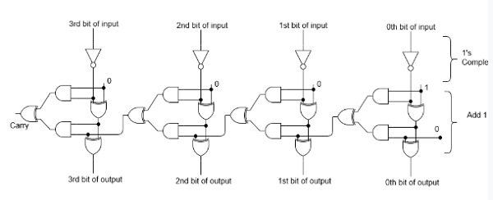
Ligical circuit of 2’s complement

Slide 10
COMPLEMENTS (3/3)
More examples:
[8-bit] What is 111₂ (7₁₀) in 2’s complement form? Answer: 00000111
[8-bit] What is -111₂ (-7₁₀) in 2’s complement form? Answer: 11111001
[10-bit] What is 14₁₀ in 1’s complement form? Answer: (0000001110)_{1s}
[10-bit] What is -14₁₀ in 2’s complement form? Answer: (1111110010)_{2s}

Slide 11
FLOATING-POINT NUMBERS (1/2)
Assume a 10-bit floating-point scheme with: 1-bit sign, 5-bit normalised mantissa, and 4-bit exponent.
What is this value: 1 11000 1001 ?
Sign bit is 1, so value is negative.
Mantissa is 0.11000₂, or 0.75₁₀
What about exponent 1001?
If exponent is unsigned, then exponent = 9
If exponent is signed, and sign-and-magnitude is used, then exponent = -1
If exponent is signed, and 1’s complement is used, then exponent = -6
If exponent is signed, and 2’s complement is used, then exponent = -7

Slide 12
FLOATING-POINT NUMBERS (2/2)
1 11000 1001
Therefore,
If exponent is unsigned, then value is -0.11₂ × 2⁹, or -110000000₂, or -384₁₀.
If exponent is in sign-and-magnitude, then value is -0.11₂ × 2⁻¹, or -0.011₂, or 0.375₁₀.
If exponent is in 1’s complement form, then value is -0.11₂ × 2⁻⁶, or -0.00000011₂.
If exponent is in 2’s complement form, then value is -0.11₂ × 2⁻⁷, or -0.000000011₂.

Slide 13
Q&A

